Slide 1
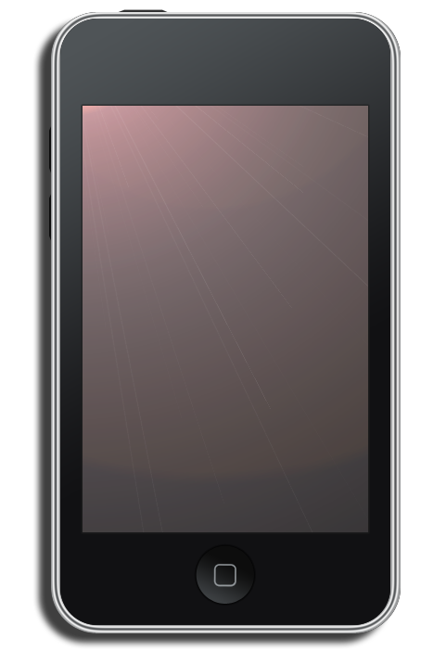
iPods and Digital Music: A Multimedia Revolution
David Schubert
April 22, 2010

Slide 2
History of Audio Recording
Analog
Phonograph cylinder (1888)
Record (1909)
Magnetic tape (1940s)
Walkman
Digital
Compact disc (1982)
Digital audio file formats (WAV/MP3) (1990s)
iPod

Slide 3
Benefits of Digital Audio
Create a media library
Store information about the media
Title, artist, genre, artist…
Sort tracks
Create playlists

Slide 4
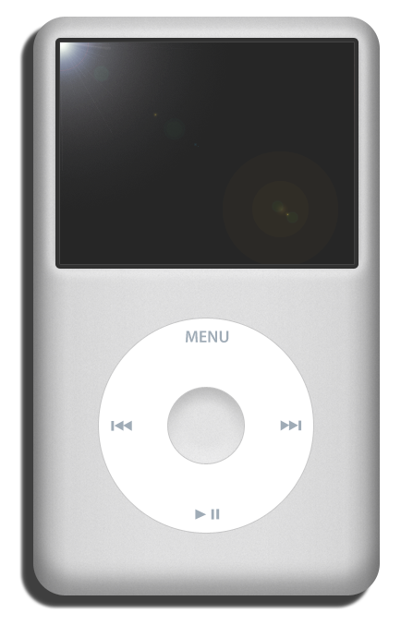
Portable Digital Audio – the iPod
Original model - 2001
5 GB (1,000 songs)
Black and white display
10 hour battery
Easy navigation
Sync with iTunes
Later models
Color display
Photos
Video
Greater capacity

Slide 5
iPod Touch and iPhone
Portable computer with multimedia applications
Fewer hardware controls; larger display
Calendar, photos, map, clock, calculator, etc.
Engaging multimedia experience
Games and third-party applications

Slide 6
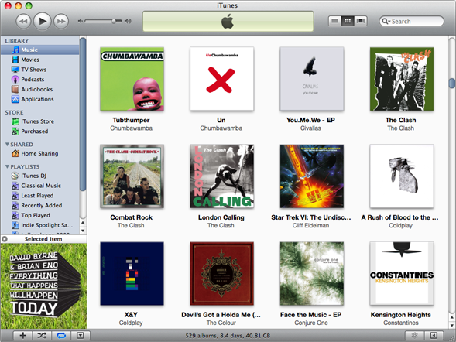
iTunes Software
Digital media manage-ment application
Digital media files contain metadata (tags)
Rip CDs or purchase digital media files
iTunes Store, Amazon
Different views and sorting options
Playlists and Genius

Slide 7
iTunes Software Demonstration

Slide 8
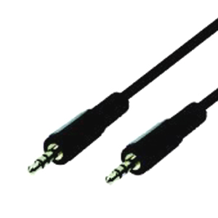
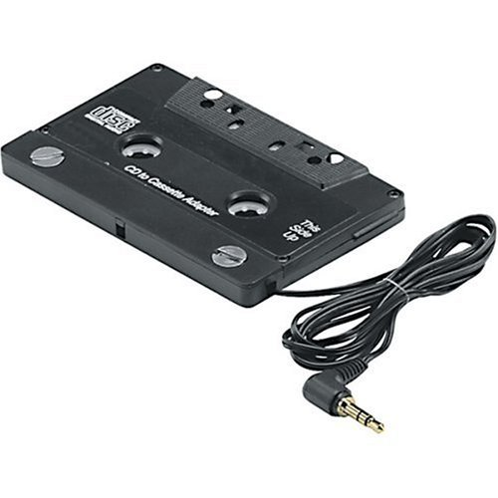
Tips and Hints
Connecting to a car stereo
3.5mm mini-stereo male-to-male audio cable
Cassette adapter
Tagging lyrics
Get Lyrical (Mac)
iTunes
Let iTunes automatically organize media folder

Slide 9
Questions?

